Slide 1
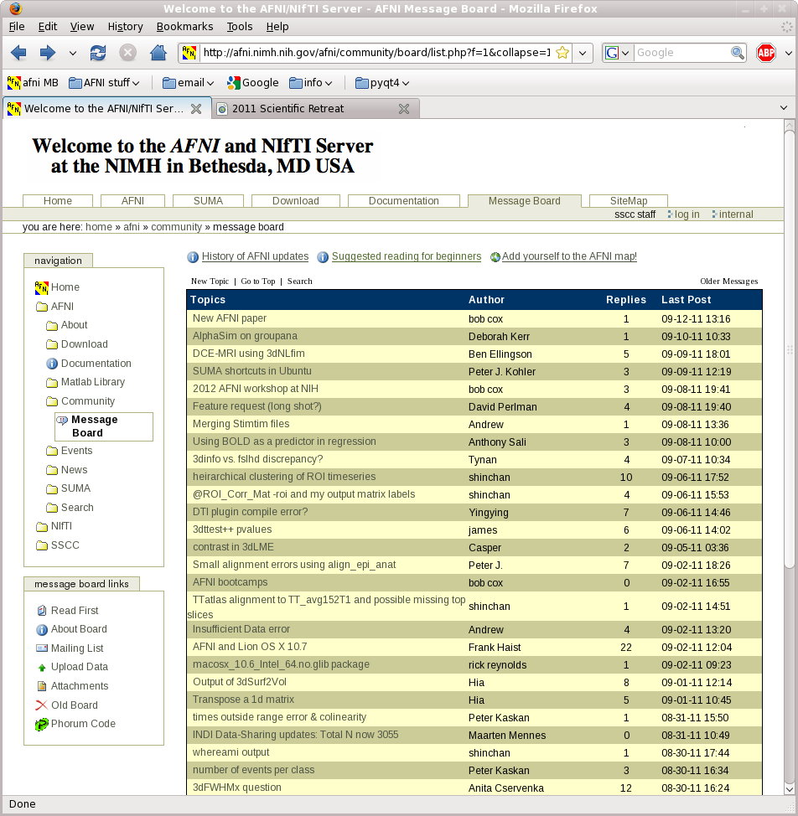
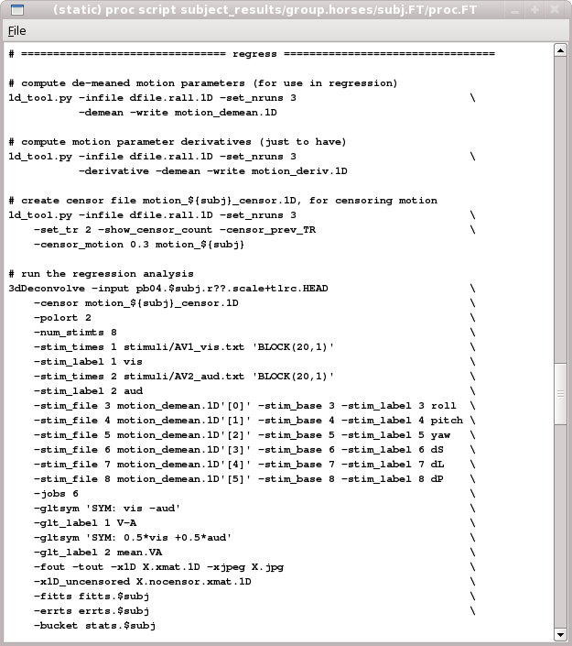
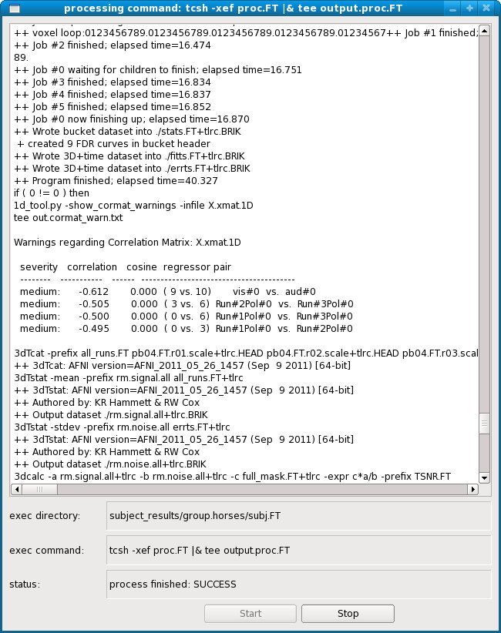
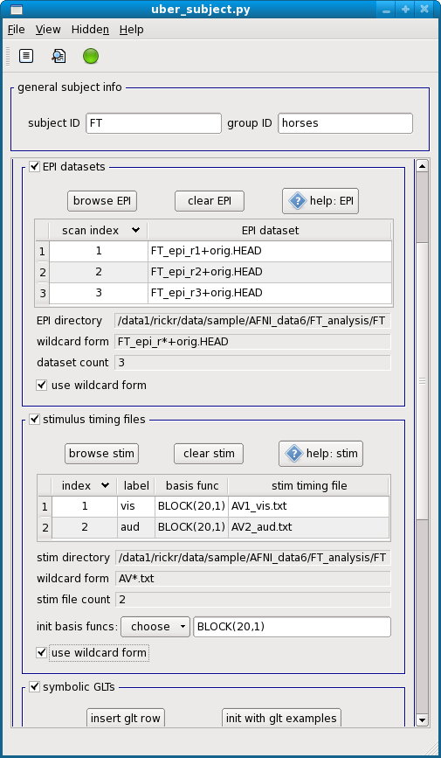
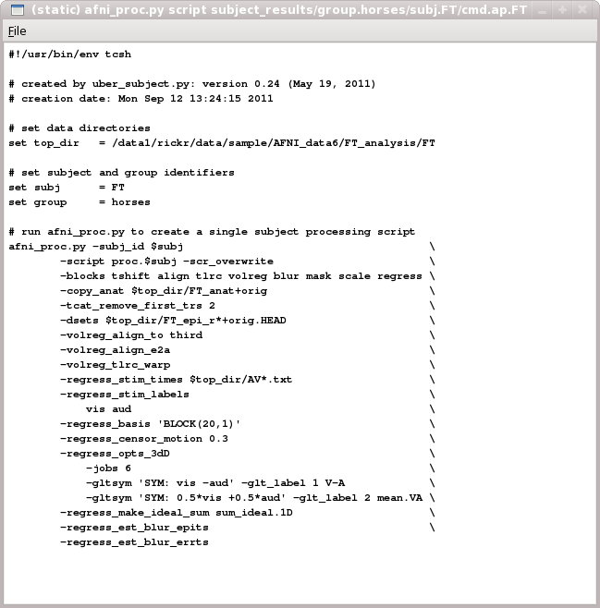
AFNI Start to Finish:
How to Analyze Data with AFNI

Slide 2
Goal: run group analysis on single subject response magnitudes
  how do we get there?
    create beta (response magnitude) maps for each subject
      should be aligned, probably to a well known template
    run group analysis program (e.g. 3dttest++, 3dMEMA, 3dANOVA*)
      can use uber_ttest.py to run single group tests
  how do we create aligned beta maps?
    write single subject processing script: pre-processing through regression
      inputs: anat, EPI, stimulus timing
      controls: processing decisions like blur size and alignment template
      outputs: beta weights (and t-stats, contrasts, blur estimates, etc.)
  how do we write single subject processing scripts?
    afni_proc.py can be used to generate processing scripts
    uber_subject.py can be used to generate afni_proc.py command
      can also run the afni_proc.py command (generates proc script)
      can also run the proc script (i.e. actually analyze the data)

Slide 3
General suggestions
  picture this experiment as your own (i.e. feel responsibility)
    decisions on processing were made by you (and your colleagues)
      hopefully before acquiring any data
    there is no single "correct" way to analyze data, just reasonable ways
  focus on understanding the processing steps
    in light of your having chosen which steps to perform
  practice the good habit of reviewing results
    do the initial images look good?
    review each processing step along with data
    are the EPI and anat well aligned by the end?
    do the resulting statistical maps look reasonable?
  create scripts for any processing steps
    they are records of how data was processed
    they are easy to apply to any new subjects
    they are easy to repeat
      expect to re-analyze everything (mistake, new decision, etc.)
      keep original data and all processing scripts

Slide 4
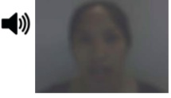
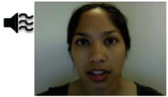
Review of stimulus conditions
Speech Perception Task: Subjects were presented with audiovisual speech that was presented in a predominantly auditory or predominantly visual modality.
A digital video system was used to capture auditory and visual speech from a female speaker.
There were 2 types of stimulus conditions:
(1) Auditory-Reliable
(2) Visual-Reliable
Example: Subjects can clearly hear the word “cat,” but the video of a woman mouthing the word is degraded.
Example: Subjects can clearly see the video of a woman mouthing the word “cat,” but the audio of the word is degraded.

Slide 5
Experiment Design:
There were 3 runs in a scanning session.
Each run consisted of 10 blocked trials:
  5 blocks contained Auditory-Reliable (Arel) stimuli, and
  5 blocks contained Visual-Reliable (Vrel) stimuli.
Each block contained 10 trials of Arel stimuli OR 10 trials of Vrel stimuli.
  Each block lasted for 20 seconds (1 second for stimulus presentation, followed by a 1-second inter-stimulus interval).
Each baseline block consisted of a 10-second fixation point.
10 stims, 20sec
10 stims, 20sec
10 stims, 20sec
10 stims, 20sec
10 stims, 20sec
etc…
+
+
+
+
+
10sec
10sec
10sec
10sec
10sec

Slide 6
Data Collected:
2 Anatomical datasets for each subject, collected at 3 tesla.
  175 sagittal slices
  voxel dimensions = 0.938 x 0.938 x 1.0 mm
3 Time Series (EPI) datasets for each subject.
  33 axial slices x 152 volumes = 5016 slices per run
  TR = 2 sec; voxel dimensions = 2.75 x 2.75 x 3.0 mm
Sample size, n = 10 (all right-handed subjects)

Slide 7
afni_proc.py uber_subject.py
What is afni_proc.py?
  a program used to generate processing scripts for single subject analysis
    command-line program
  generated scripts are in tcsh syntax
  scripts are written to be easily read and modified
What is uber_subject.py?
  for running single subject analysis
  a graphical user interface to afni_proc.py
  quickly create processing scripts
  can analyze all subjects from GUI
  good for learning
    FMRI processing, shell scripting, AFNI commands
    can compare against manually generated scripts
      for sanity, bug detection, quick evaluation

Slide 8
Overview of remaining steps
  cd AFNI_data6/FT_analysis
    review directory contents and note subject data under directory FT
  from the home directory, run uber_subject.py and analyze subject FT
    set subject ID, group ID
    specify inputs: anat, EPI, stimulus timing files (all under FT_analysis/FT)
    controls: BLOCK(20,1), init GLTs, remove first 2 TRs
    peruse other options, e.g. multiple CPUs for 3dDeconvolve?
    create afni_proc.py command
    execute afni_proc.py command (to create proc script)
    execute proc script (analyze subject data)
  briefly review processing script
  review proc script in modest detail, while viewing processed data
    run afni from FT.results directory and follow script
    run resulting @ss_review_driver script
  run group analysis (3dttest++, 3dMEMA or 3dANOVA2)
    run uber_ttest.py on data under AFNI_data6/group_results
    or run existing s1.3dANOVA2 script

Slide 9
Note what is under AFNI_data6/FT_analysis
  FT - subject data directory
  s01.ap.simple - basic afni_proc.py script
  s02.ap.align - more advanced script
  s09.cleanup - remove analysis results
  s11.proc.FT - result of s01.ap.simple
  s12.proc.FT.align - result of s01.ap.align
  under FT
    AV1_vis.txt - visual reliable timing
    AV2_aud.txt - auditory reliable timing
    FT_anat+orig.BRIK/HEAD - anatomical dataset
    FT_epi_r1+orig.BRIK/HEAD - EPI run 1
    FT_epi_r2+orig.BRIK/HEAD - EPI run 2
    FT_epi_r3+orig.BRIK/HEAD - EPI run 3
  AV1_vis.txt:
    60 90 120 180 240
    120 150 180 210 270
    0 60 120 150 240

Slide 10
Single Subject Analysis: FT
  from home directory (use the cd command), run uber_subject.py &
  uber_subject.py setup:
    subject ID FT, group ID horses
    browse anat: choose AFNI_data6/FT_anaysis/FT/FT_anat+orig.HEAD
    browse EPI: choose FT_epi_r1+orig.HEAD (and epi_r2 and epi_r3)
      select all 3 data files with ctrl or shift keys, then hit Open
    browse stim: choose AV1_vis.txt and AV2_aud.txt
    stimuli: set both basis functions to BLOCK(20,1)
      init basis funcs to BLOCK(5,1), change 5 to 20 and hit Enter
    symbolic GLTs: click to view option frame and init with glt examples
    expected options: remove first 2 TRs per run
    optional: see “extra regress options”
      jobs for regression: 2 (if computer has many CPUs, use more)
      run cluster simulation: no (if 1 thread, this can take a long time)
      compute fitts dataset: set (reduces needed RAM)

Slide 11
Single Subject Analysis: FT
  uber_subject.py: generate scripts and process data
    generate afni_proc.py command (left action button)
    generate proc script (middle action button)
    process this subject (right action button)
    scripts/results are under subject_results/group.horses/subj.FT
  (alternate analysis method, for those who cannot run uber_subject.py)
    (only do this if you were not able to use uber_subject.py)
    cd AFNI_data6/FT_analysis
    tcsh s04.cmd.usubj
    results are under ~/subject_results/group.horses/subj.FT
  review processing script and results
    review the proc.FT script while looking at the results under FT.results
      cd subject_results/group.horses/subj.FT
      cd FT.results ; afni &
    after script and data review, run ./@ss_review_driver
      considered a minimal data review (run for every subject)

Slide 12
Group Analysis: paired t-test (Vrel-Arel)
  from home directory, run uber_ttest.py &
      using data from under AFNI_data6/group_results
    program 3dttest++, script script.V-A, prefix ttest.V-A, mask dset: skip
    choose paired test
    fill "datasets A" table with datasets for Vrel betas
      get subj dsets
        choose file : OLSQ.FP.betas+tlrc.HEAD
        alter name into wildcard pattern: replace "FP" with "*"
        press Enter or apply pattern button (should have 10 datasets)
        press OK (at bottom)
      set name Vrel, data index Vrel#0_Coef (or index 0), t-stat index: skip
    fill "datasets B" table with datasets for Arel betas
      identical table of datasets, so choose copy other table
        set Arel, data index Arel#0_Coef, t-stat index: skip
    generate processing script: press left action button (note hint)
    execute processing script: press green action button (note hint)
  script/output/results are under: group_results/test.001.3dttest++
  script is script.V-A, results are under ttest.results
  cd group_results/test.001.3dttest++/ttest.results (practice <tab> key)
  afni &

Slide 13
Additional comments
  inputs for subject FT are under AFNI_data6/FT_analysis/FT
  results from uber_*.py go where the program was run
    uber_subject.py: subject_results/group.GROUP/subj.SUBJECT
    uber_ttest.py: group_results/test.INDEX.PROGRAM
    so in class, these directory trees should end up under the home directory
  it is not necessary to master all shell script details
    but want to understand processing steps
  when analyzing data, run @ss_review_driver for every subject
    script represents the minimum of what to look at for each subject
    for the first few subjects analyzed, look at all results in detail
      in more detail than the level of this class
      before acquiring many subjects

Slide 14
AFNI Start to Finish
(the horror continues...)
To continue reviewing the data on your own, please see the corresponding tutorial that continues under the data directory:
    AFNI_data6/FT_analysis/tutorial
Alternatively, this can be viewed from the AFNI web site:
http://afni.nimh.nih.gov/pub/dist/edu/data/CD.expanded/AFNI_data6/FT_analysis/tutorial
or from the Help menu of uber_subject.py
  Help --> Browse --> web: tutorial-single subject analysis

